Slide 1
Linear Regression
Dr. Mehmet Yasin Ulukuş

Slide 2
Linear Regression
A very simple approach for supervised learning
Still a useful and widely used statistical learning method although it may seem somewhat dull compared to some of the more modern statistical learning approaches
Many fancy statistical learning approaches can be seen as generalizations or extensions of linear regression
A good understanding of linear regression before studying more complex learning methods is vital
Results are more interpretable compared to other approaches

Slide 3
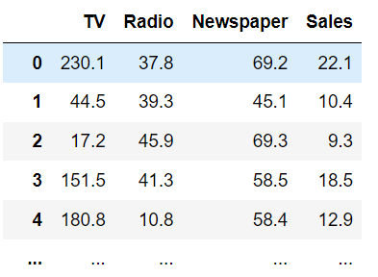
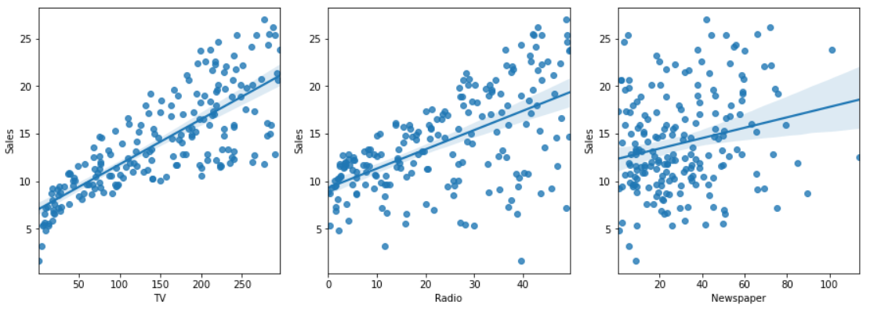
Linear Regression
Advertising data that consists of the sales of that product in 200 different markets, along with advertising budgets for the product in each of those markets for three different media: TV, radio, and newspaper

Slide 4
Linear Regression
Here are a few important questions that we will be able to address using Linear Regression
Is there a relationship between advertising budget and sales?
How strong is the relationship between advertising budget and sales?
Which media contribute to sales?
How accurately can we estimate the effect of each medium on sales?
How accurately can we predict future sales?
Is the relationship linear?
Is there synergy among the advertising media?

Slide 5
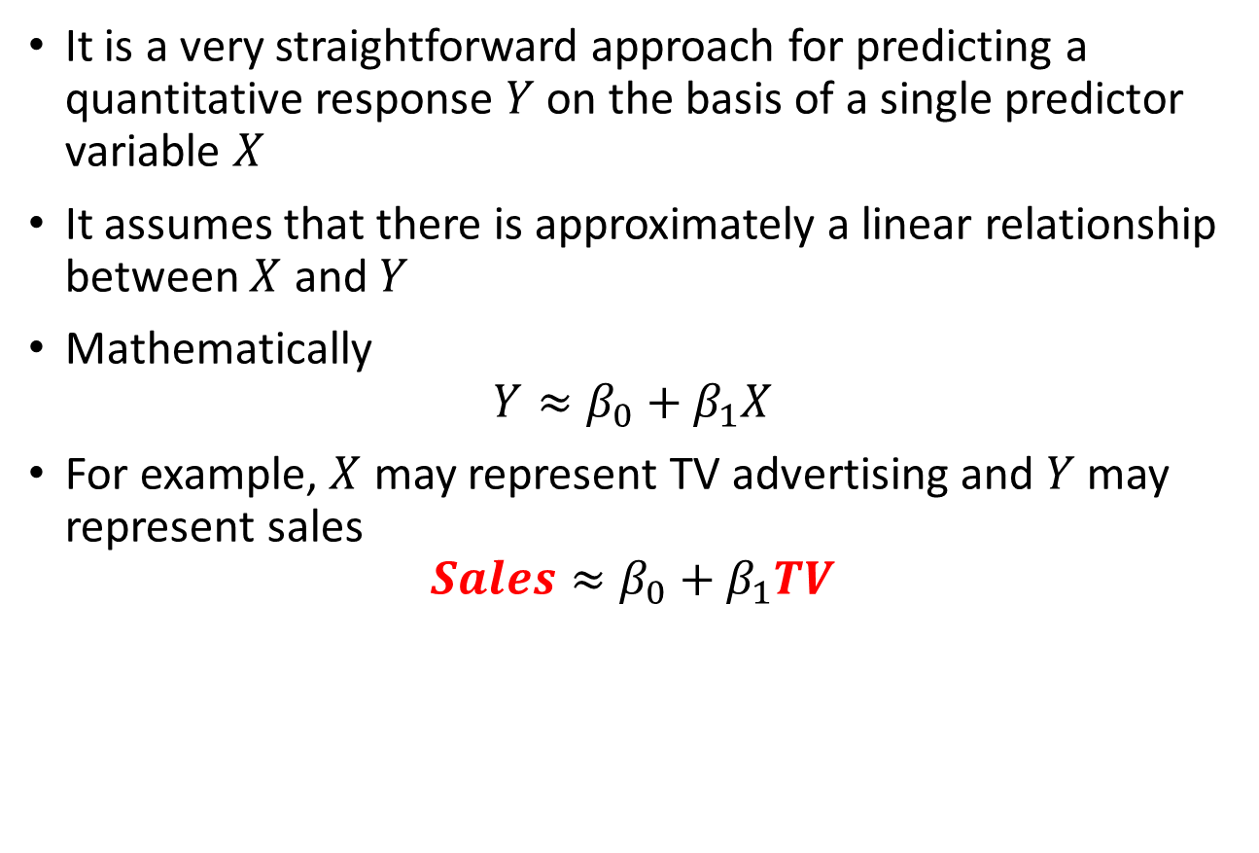
Simple Linear Regression
It is a very straightforward approach for predicting a quantitative response $Y$ on the basis of a single predictor variable $X$
It assumes that there is approximately a linear relationship between $X$ and $Y$
Mathematically
$$Y≈β_{0}+β_{1}X$$
For example, $X$ may represent TV advertising and $Y$ may represent sales
$$Sales≈β_{0}+β_{1}TV$$

Slide 6
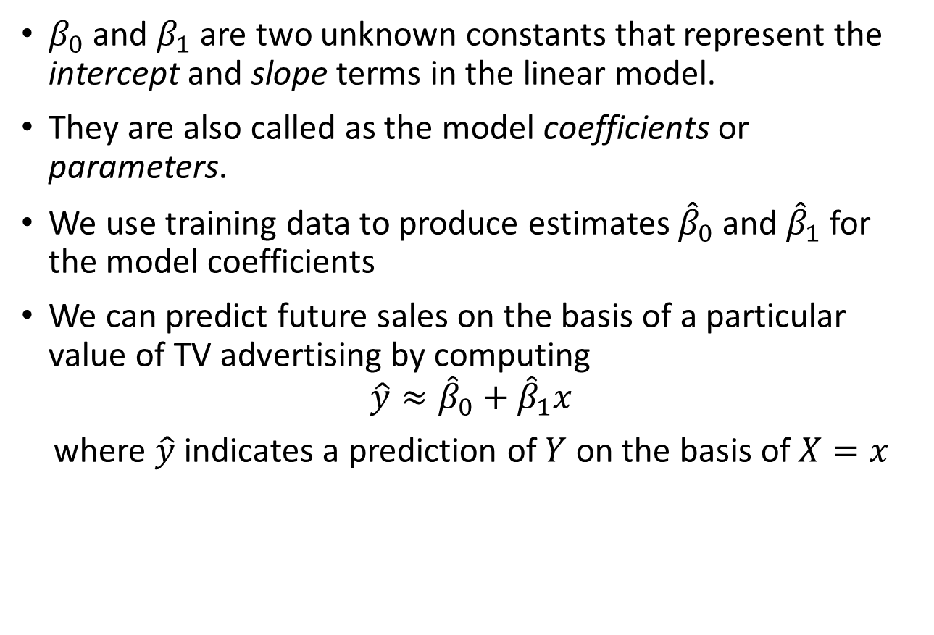
Simple Linear Regression
$β_{0}$ and $β_{1}$ are two unknown constants that represent the intercept and slope terms in the linear model.
They are also called as the model coefficients or parameters.
We use training data to produce estimates ${\hat{β}}_{0}$ and ${\hat{β}}_{1}$ for the model coefficients
We can predict future sales on the basis of a particular value of TV advertising by computing
$$\hat{y}≈{\hat{β}}_{0}+{\hat{β}}_{1}x$$
where $\hat{y}$ indicates a prediction of $Y$ on the basis of $X=x$

Slide 7
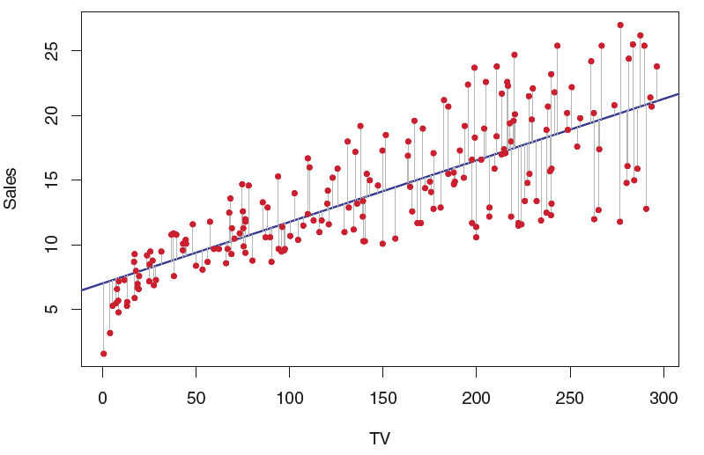
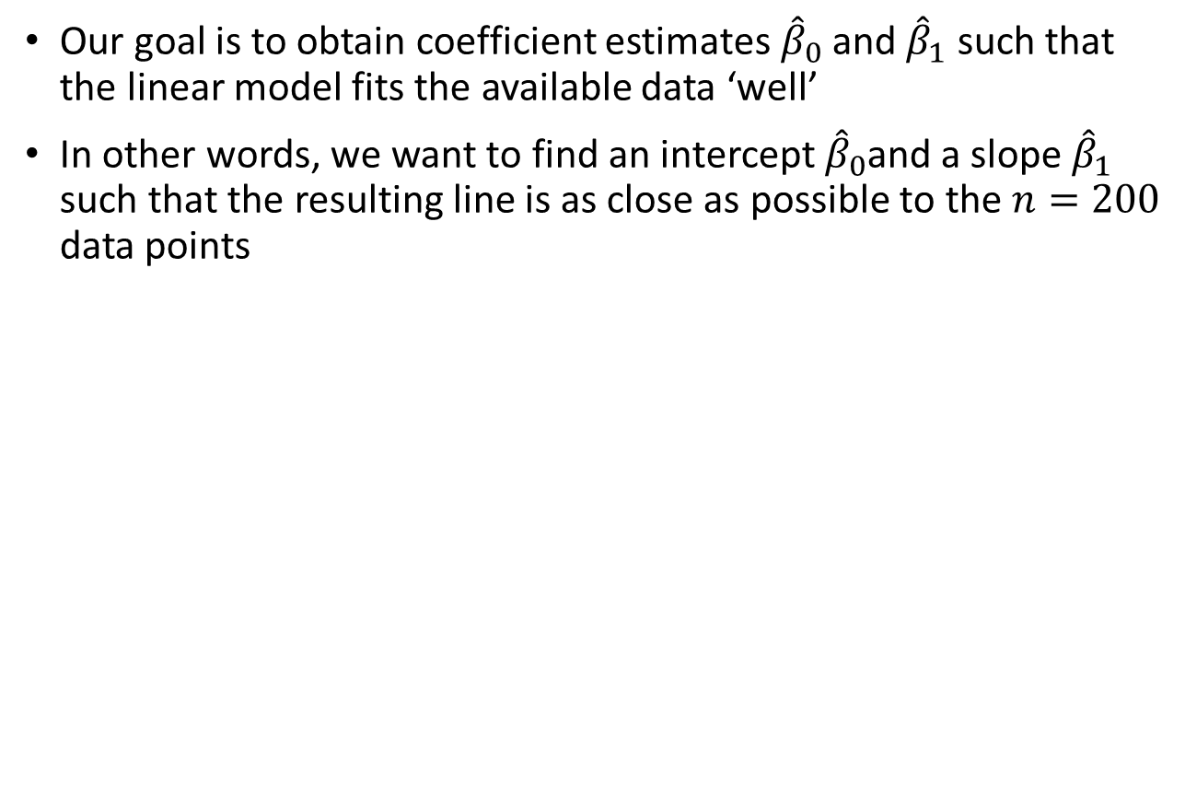
Simple Linear Regression:Estimating Coefficients
Our goal is to obtain coefficient estimates ${\hat{β}}_{0}$ and ${\hat{β}}_{1}$ such that the linear model fits the available data ‘well’
In other words, we want to find an intercept ${\hat{β}}_{0}$and a slope ${\hat{β}}_{1}$ such that the resulting line is as close as possible to the $n=200$ data points

Slide 8
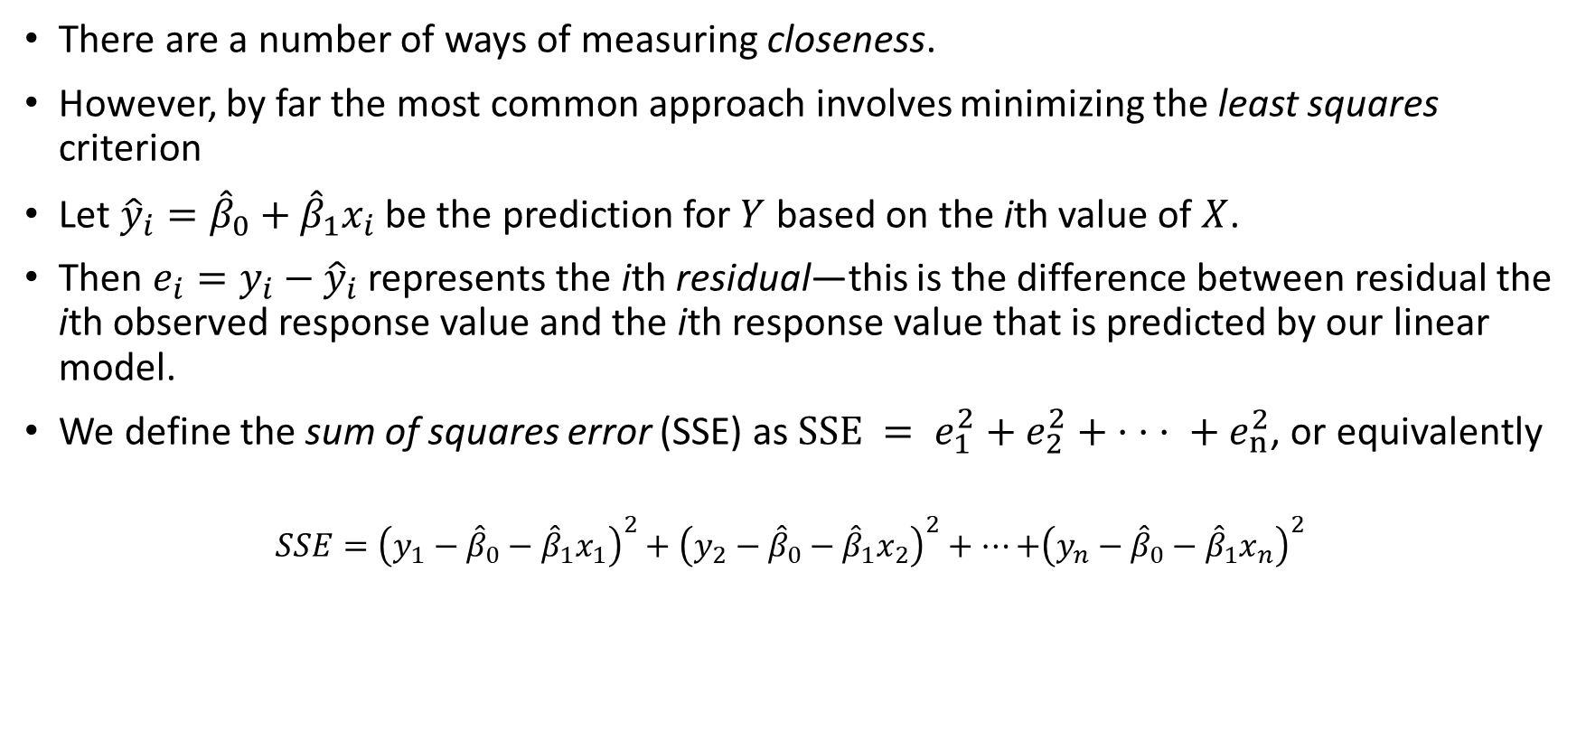
Simple Linear Regression:Estimating Coefficients
There are a number of ways of measuring closeness.
However, by far the most common approach involves minimizing the least squares criterion
Let ${\hat{y}}_{i}={\hat{β}}_{0}+{\hat{β}}_{1}x_{i}$be the prediction for $Y$ based on the ith value of $X$.
Then $e_{i}=y_{i}−{\hat{y}}_{i}$represents the ith residual—this is the difference between residual the ith observed response value and the ith response value that is predicted by our linear model.
We define the sum of squares error (SSE) as $SSE = e_{1}^{2}+e_{2}^{2}+ · · · + e_{n}^{2}$, or equivalently
$$SSE={\left(y_{1}−{\hat{β}}_{0}−{\hat{β}}_{1}x_{1}\right)}^{2}+{\left(y_{2}−{\hat{β}}_{0}−{\hat{β}}_{1}x_{2}\right)}^{2}+…\text{+}{\left(y_{n}−{\hat{β}}_{0}−{\hat{β}}_{1}x_{n}\right)}^{2}$$

Slide 9
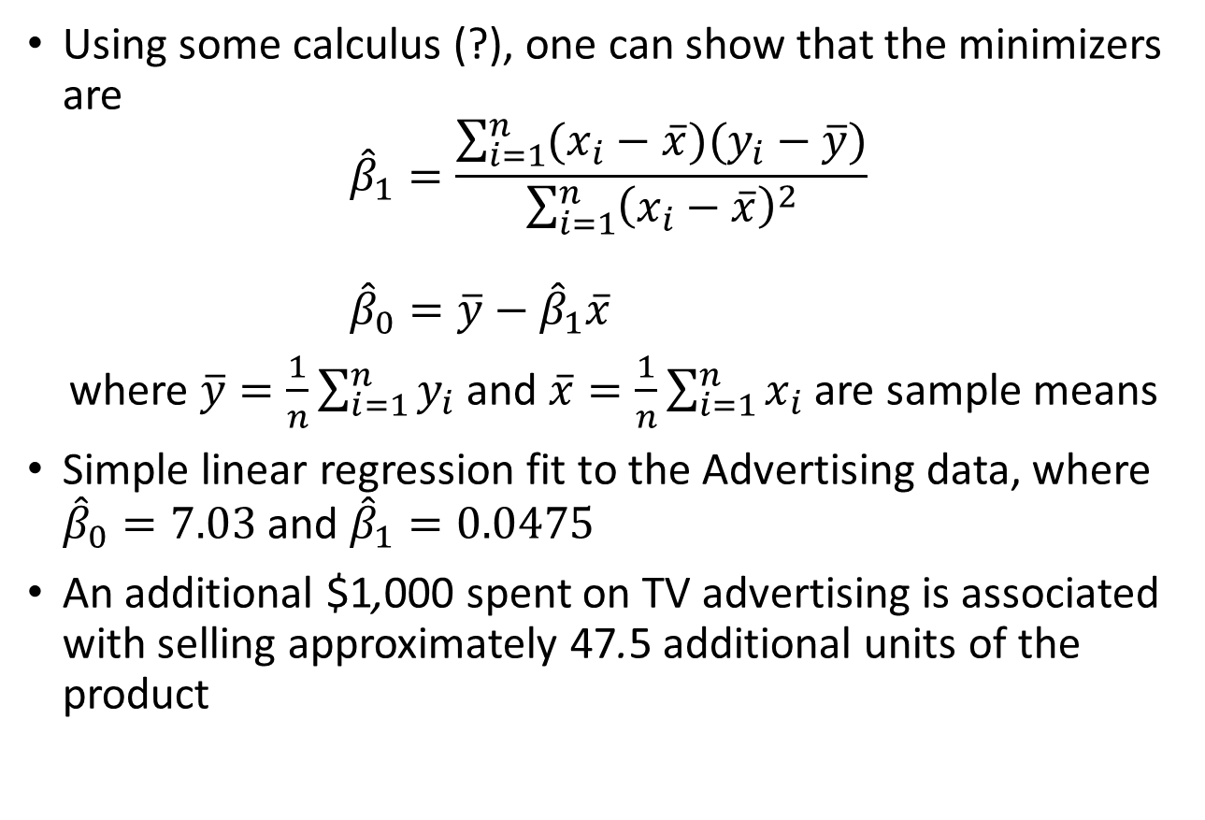
Simple Linear Regression:Estimating Coefficients
Using some calculus (?), one can show that the minimizers are
$${\hat{β}}_{1}=\frac{\sum_{i=1}^{n}{(x_{i}−\overline{x})(y_{i}−\overline{y})}}{\sum_{i=1}^{n}{{\left(x_{i}−\overline{x}\right)}^{2}}} \\ {\hat{β}}_{0}=\overline{y}−{\hat{β}}_{1}\overline{x}$$
where $\overline{y}=\frac{1}{n}\sum_{i=1}^{n}{y_{i}}$ and $\overline{x}=\frac{1}{n}\sum_{i=1}^{n}{x_{i}}$ are sample means
Simple linear regression fit to the Advertising data, where ${\hat{β}}_{0}=7.03$ and ${\hat{β}}_{1}=0.0475$
An additional $1,000 spent on TV advertising is associated with selling approximately 47.5 additional units of the product

Slide 10



Gradient Descent
This problem can also be solved iteratively using an algorithm called gradient descent algorithm.
This is a general purpose optimization algorithm.
A blind person finds himself in a valley and wants to get into the bottom of the valley
He checks his neighborhood, and takes a step in the direction of downward
Again he checks his neighborhood and finds the direction of downward and takes a step in that direction
He goes down until no neighborhood is has a downward direction
$$SSE$$
$$β$$

Slide 11
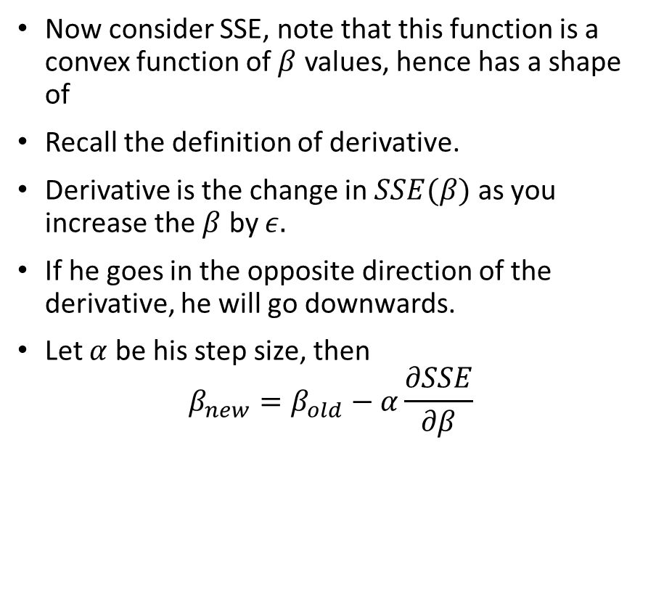
Gradient Descent
Now consider SSE, note that this function is a convex function of $β$ values, hence has a shape of
Recall the definition of derivative.
Derivative is the change in $SSE(β)$ as you increase the $β$ by $ε.$
If he goes in the opposite direction of the derivative, he will go downwards.
Let $α$ be his step size, then
$$β_{new}=β_{old}−α\frac{∂SSE}{∂β}$$
$$SSE$$
$$β$$

Slide 12
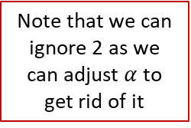

Gradient Descent for Least Square
Compute gradients
$$\frac{∂SSE}{∂β_{0}}=2\sum_{i=1}{\left(β_{0}+β_{1}x_{i1}+β_{2}x_{i2}+…+β_{p}x_{ip}−y_{i}\right)}⋅1 \\ \frac{∂SSE}{∂β_{1}}=2\sum_{i=1}{\left(β_{0}+β_{1}x_{i1}+β_{2}x_{i2}+…+β_{p}x_{ip}−y_{i}\right)}⋅ x_{i1} \\ ⋮ \\ \frac{∂SSE}{∂β_{p}}=2\sum_{i=1}{\left(β_{0}+β_{1}x_{i1}+β_{2}x_{i2}+…+β_{p}x_{ip}−y_{i}\right)}⋅ x_{ip}$$
Hence
$$β_{0,new}=β_{0,old}−α\frac{∂SSE}{∂β_{0}} \\ β_{1,new}=β_{1,old}−α\frac{∂SSE}{∂β_{1}} \\ ⋮ \\ β_{p,new}=β_{p,old}−α\frac{∂SSE}{∂β_{p}}$$
Note that we can ignore 2 as we can adjust $α$ to get rid of it

Slide 13
Gradient Descent for Least Square
Randomly initialize parameters
Calculate SSE values with given parameters
Calculate gradients
Update parameters given gradients
Repeat steps 2-4

Slide 14
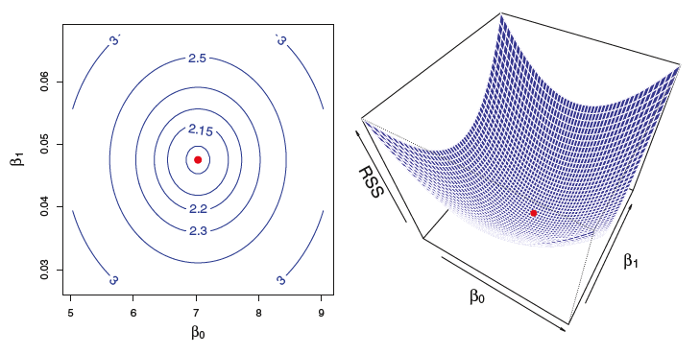

Simple Linear Regression:Estimating Coefficients
Contour and three-dimensional plots of the RSS on the Advertising data, using sales as the response and TV as the predictor. (Convex)
The Simple linear regression fit to the Advertising data, where ${\hat{β}}_{0}=7.03$ and ${\hat{β}}_{1}=0.0475$
These values clearly minimize the SSE

Slide 15
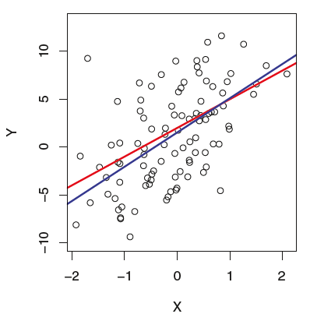
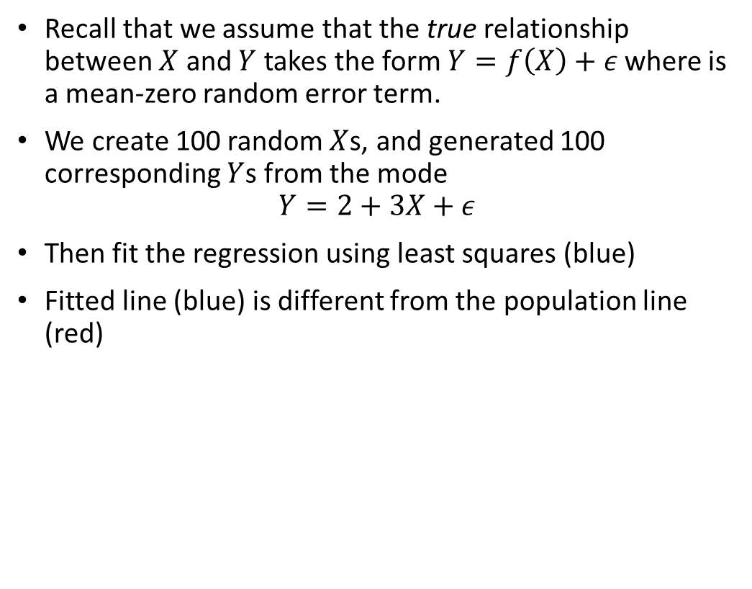
Simple Linear Regression: Accuracy of Coefficients
Recall that we assume that the true relationship between $X$ and $Y$ takes the form $Y=f\left(X\right)+ε$where is a mean-zero random error term.
We create 100 random $X$s, and generated 100 corresponding $Y$s from the mode
$$Y=2+3X+ε$$
Then fit the regression using least squares (blue)
Fitted line (blue) is different from the population line (red)

Slide 16
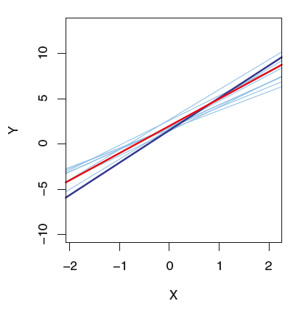
Simple Linear Regression: Accuracy of Coefficients
We repeat the procedure ten times
Notice that different data sets generated from the same true model result in slightly different least squares lines, but the unobserved population regression line does not change
Fundamentally, the concept of these two lines is a natural extension of the standard statistical approach of using information from a sample to estimate characteristics of a large population

Slide 17
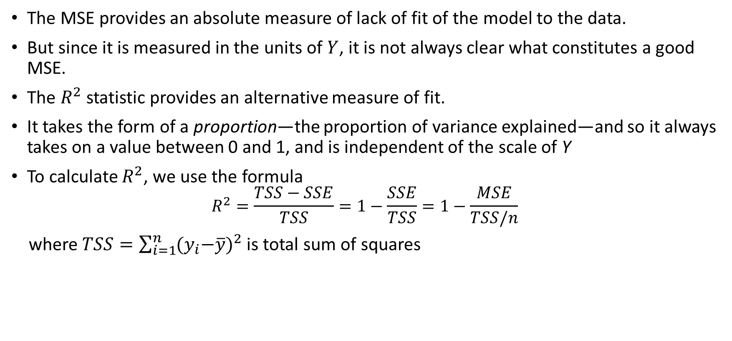
Simple Linear Regression: Accuracy of Model
The MSE provides an absolute measure of lack of fit of the model to the data.
But since it is measured in the units of $Y$, it is not always clear what constitutes a good MSE.
The $R^{2}$statistic provides an alternative measure of fit.
It takes the form of a proportion—the proportion of variance explained—and so it always takes on a value between 0 and 1, and is independent of the scale of Y
To calculate $R^{2}$, we use the formula
$$R^{2}=\frac{TSS−SSE}{TSS}=1−\frac{SSE}{TSS}=1−\frac{MSE}{TSS/n}$$
where $TSS=\sum_{i=1}^{n}{{{(y}_{i}−\overline{y})}^{2}}$ is total sum of squares

Slide 18
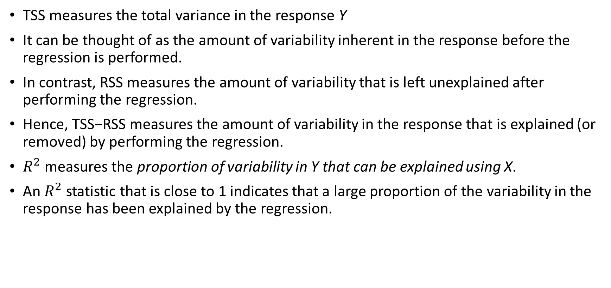
Simple Linear Regression:Accuracy of Model
TSS measures the total variance in the response Y
It can be thought of as the amount of variability inherent in the response before the regression is performed.
In contrast, RSS measures the amount of variability that is left unexplained after performing the regression.
Hence, TSS−RSS measures the amount of variability in the response that is explained (or removed) by performing the regression.
$R^{2}$measures the proportion of variability in Y that can be explained using X.
An $R^{2}$ statistic that is close to 1 indicates that a large proportion of the variability in the response has been explained by the regression.

Slide 19
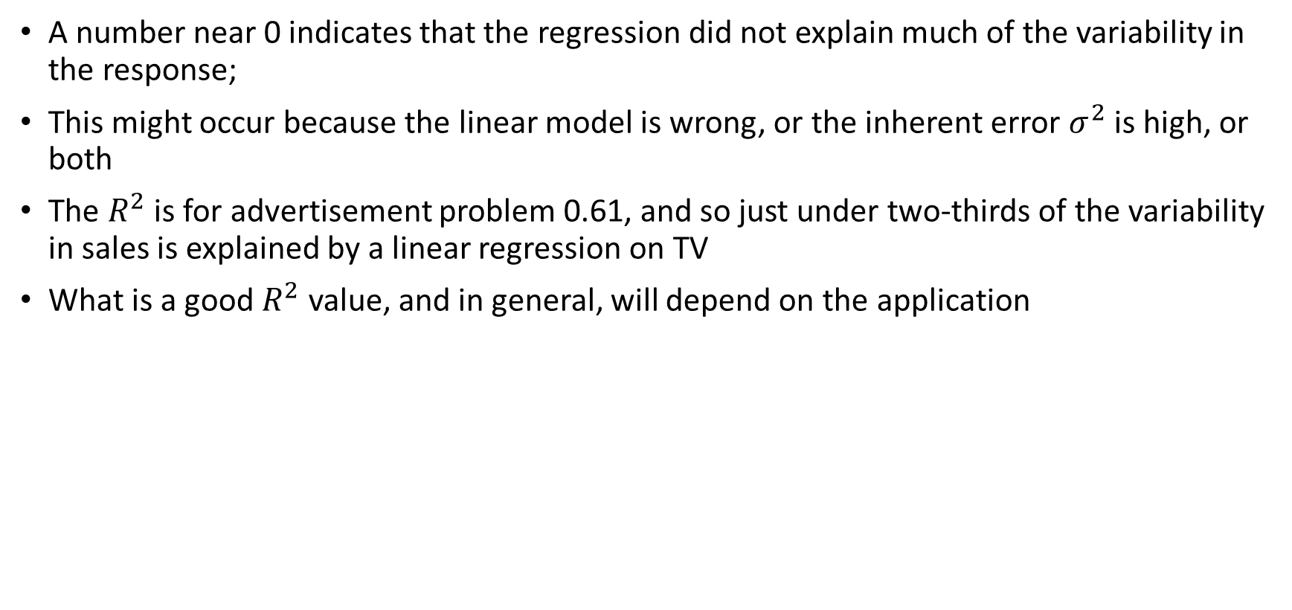
Simple Linear Regression:Accuracy of Model
A number near 0 indicates that the regression did not explain much of the variability in the response;
This might occur because the linear model is wrong, or the inherent error $σ^{2}$ is high, or both
The $R^{2}$ is for advertisement problem 0.61, and so just under two-thirds of the variability in sales is explained by a linear regression on TV
What is a good $R^{2}$ value, and in general, will depend on the application

Slide 20
Multiple Linear Regression
Simple linear regression is a useful approach for predicting a response on the basis of a single predictor variable.
However, in practice we often have more than one predictor
We also have data for the amount of money spent advertising on the radio and in newspapers, and we may want to know whether either of these two media is associated with sales.
One option is to run three separate simple linear regressions, each of which uses a different advertising medium as a predictor
However, it is unclear how to make a single prediction of sales given levels of the three advertising media budgets.
Also, each of the three regression equations ignores the other two media in forming estimates for the regression coefficients.

Slide 21
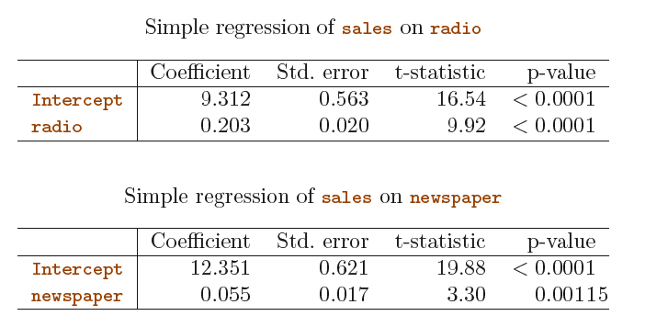
Multiple Linear Regression
We will see shortly that if the media budgets are correlated with each other in the 200 markets that constitute our data set, then this can lead to very misleading estimates of the individual media effects on sales

Slide 22
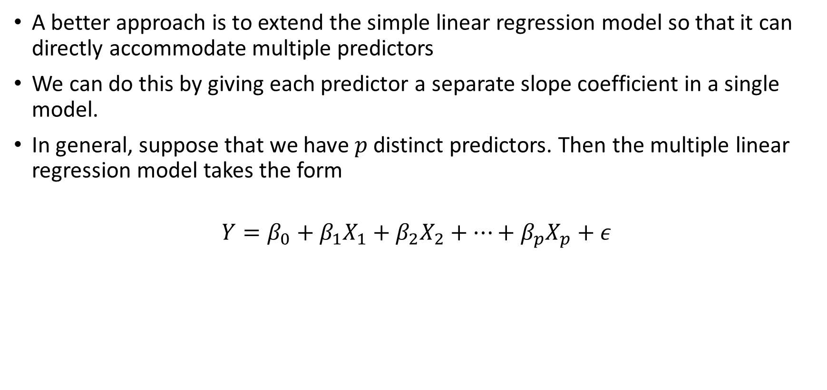
Multiple Linear Regression
A better approach is to extend the simple linear regression model so that it can directly accommodate multiple predictors
We can do this by giving each predictor a separate slope coefficient in a single model.
In general, suppose that we have $p$ distinct predictors. Then the multiple linear regression model takes the form
$$Y=β_{0}+β_{1}X_{1}+β_{2}X_{2}+…+β_{p}X_{p}+ε$$

Slide 23
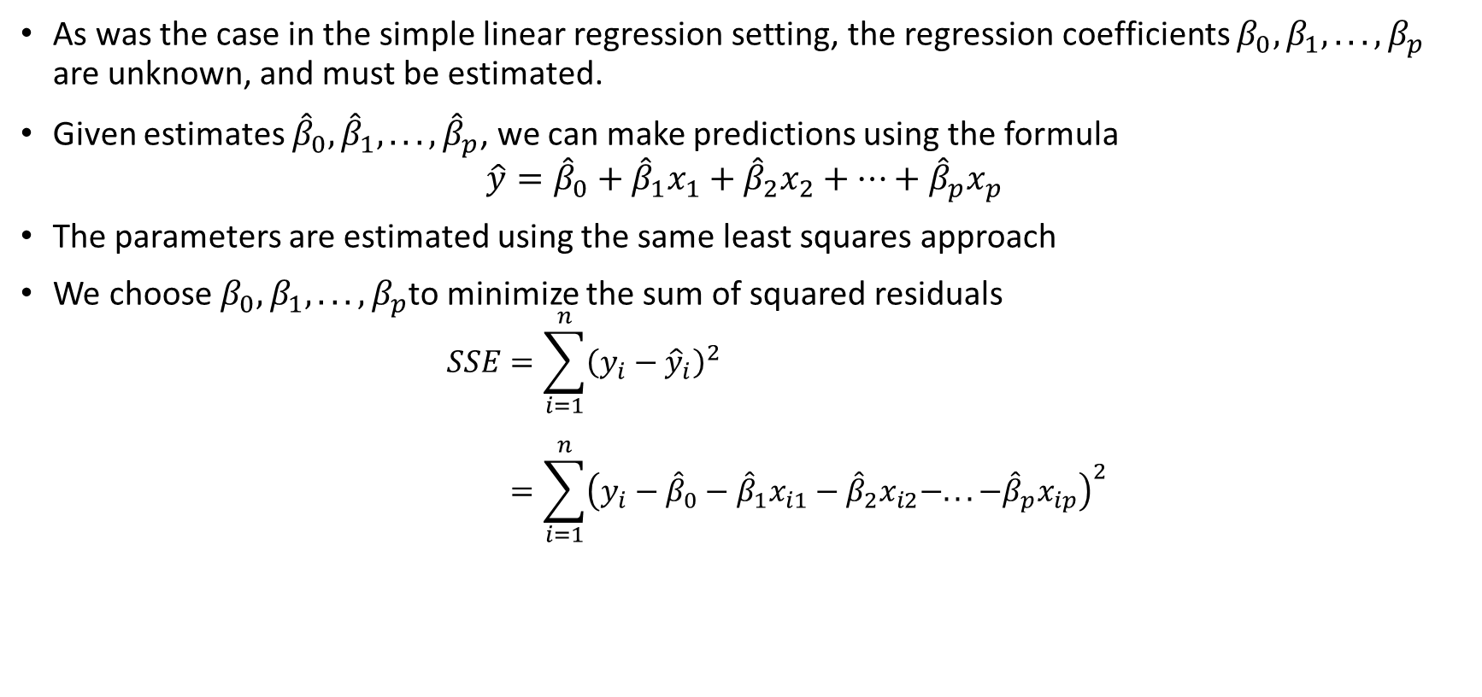
Multiple Linear Regression: Estimating Coefficients
As was the case in the simple linear regression setting, the regression coefficients $β_{0}, β_{1}, . . . , β_{p}$ are unknown, and must be estimated.
Given estimates ${\hat{β}}_{0},{\hat{β}}_{1}, . . . ,{\hat{β}}_{p}$, we can make predictions using the formula
$$\hat{y}={\hat{β}}_{0}+{\hat{β}}_{1}x_{1}+{\hat{β}}_{2}x_{2}+…+{\hat{β}}_{p}x_{p}$$
The parameters are estimated using the same least squares approach
We choose $β_{0}, β_{1}, . . . , β_{p}$to minimize the sum of squared residuals
$$SSE=\sum_{i=1}^{n}{{\left(y_{i}−{\hat{y}}_{i}\right)}^{2}} \\ =\sum_{i=1}^{n}{{\left(y_{i}−{\hat{β}}_{0}−{\hat{β}}_{1}x_{i1}−{\hat{β}}_{2}x_{i2}−. . . −{\hat{β}}_{p}x_{ip}\right)}^{2}}$$

Slide 24
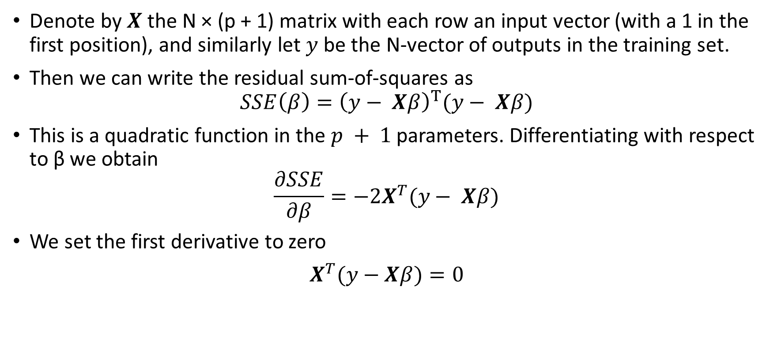
Multiple Linear Regression: Estimating Coefficients
Denote by $X$ the N × (p + 1) matrix with each row an input vector (with a 1 in the first position), and similarly let $y$ be the N-vector of outputs in the training set.
Then we can write the residual sum-of-squares as
$$SSE\left(β\right)={\left(y− Xβ\right)}^{T}(y− Xβ)$$
This is a quadratic function in the $p + 1$parameters. Differentiating with respect to β we obtain
$$\frac{∂SSE}{∂β}=−2X^{T}(y− Xβ)$$
We set the first derivative to zero
$X^{T}(y−$ $Xβ)=0$

Slide 25
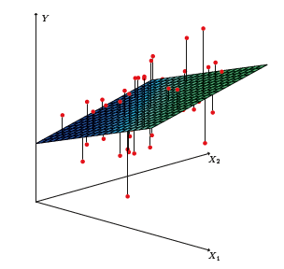

Multiple Linear Regression: Estimating Coefficients
We obtain the unique solution
$$\hat{β}={\left(X^{T}X\right)}^{−1}X^{T}y$$
Predicted values are
$$\hat{y}=X\hat{β}=X{\left(X^{T}X\right)}^{−1}X^{T}y$$
In a three-dimensional setting, with two predictors and one response,
the least squares regression line becomes a plane. The plane is chosen
to minimize the sum of the squared vertical distances between each observation
(shown in red) and the plane.

Slide 26
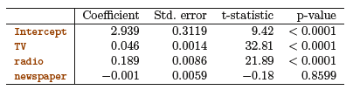
Multiple Linear Regression: Estimating Coefficients
Table 3.4 displays the multiple regression coefficient estimates when TV, radio, and newspaper advertising budgets are used
We interpret these results as follows: for a given amount of TV and newspaper advertising, spending an additional $1,000 on radio advertising leads to an increase in sales by approximately 189 units.

Slide 27
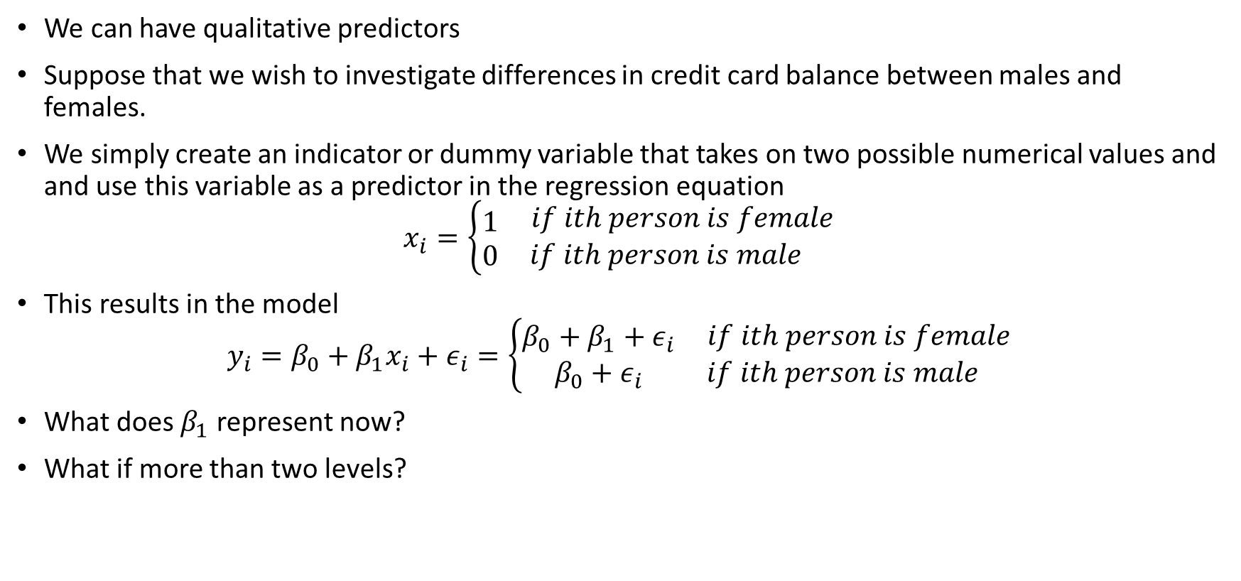
Linear Regression Extensions: Qualitative Predictors
We can have qualitative predictors
Suppose that we wish to investigate differences in credit card balance between males and females.
We simply create an indicator or dummy variable that takes on two possible numerical values and and use this variable as a predictor in the regression equation
$$x_{i}=\left\{\begin{matrix}1 \\ 0\end{matrix}\begin{aligned} if ith person is female \\ if ith person is male\end{aligned}\right.$$
This results in the model
$$y_{i}=β_{0}+β_{1}x_{i}+ε_{i}=\left\{\begin{matrix}β_{0}+β_{1}+ε_{i} \\ β_{0}+ε_{i}\end{matrix}\begin{aligned} if ith person is female \\ if ith person is male\end{aligned}\right.$$
What does $β_{1}$ represent now?
What if more than two levels?

Slide 28
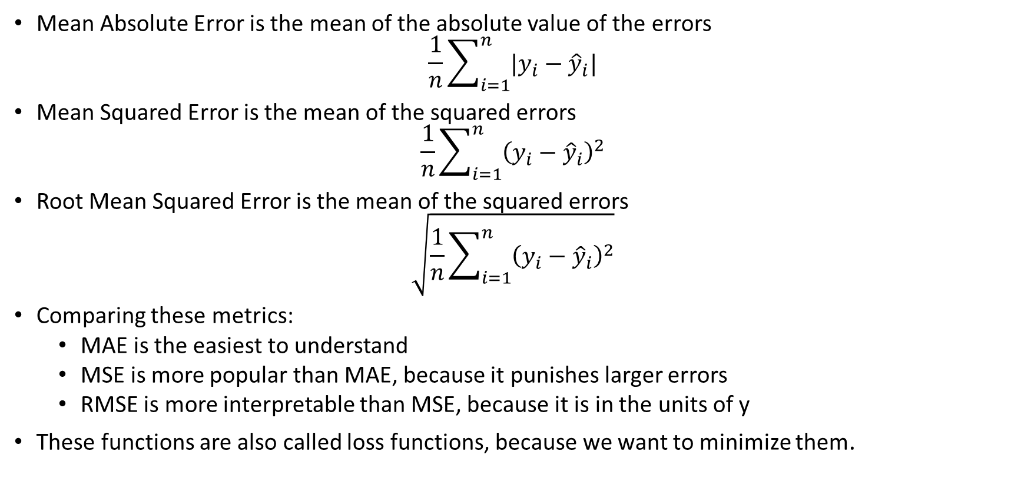
Other Performance Metrics
Mean Absolute Error is the mean of the absolute value of the errors
$$\frac{1}{n}\sum_{i=1}^{n}{|y_{i}−{\hat{y}}_{i}|}$$
Mean Squared Error is the mean of the squared errors
$$\frac{1}{n}\sum_{i=1}^{n}{{\left(y_{i}−{\hat{y}}_{i}\right)}^{2}}$$
Root Mean Squared Error is the mean of the squared errors
$$\sqrt{\frac{1}{n}\sum_{i=1}^{n}{{\left(y_{i}−{\hat{y}}_{i}\right)}^{2}}}$$
Comparing these metrics:
MAE is the easiest to understand
MSE is more popular than MAE, because it punishes larger errors
RMSE is more interpretable than MSE, because it is in the units of y
These functions are also called loss functions, because we want to minimize them.

Slide 29
Linear Regression Extensions: Non-Linear Relationship
As discussed previously, the linear regression model assumes a linear relationship between the response and predictors
In some cases, the true relationship between the response and the predictors may be nonlinear
Here we present a very simple way to directly extend the linear model to accommodate non-linear relationships, using polynomial regression

Slide 30
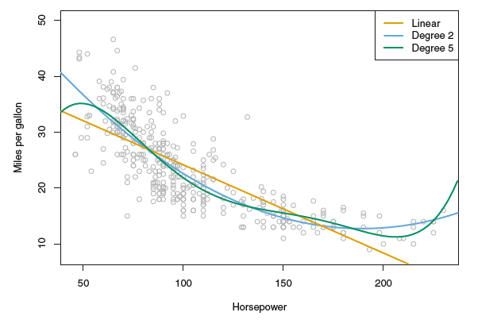
Linear Regression Extensions: Non-Linear Relationship
Consider Car example, in which the mpg (gas mileage in miles per gallon) versus horsepower is shown for a number of cars in the Auto data set

Slide 31

Linear Regression Extensions: Non-Linear Relationship
Consider Car example, in which the mpg (gas mileage in miles per gallon) versus horsepower is shown for a number of cars in the Auto data set
The data suggest a curved relationship
A simple approach for incorporating non-linear associations in a linear model is to include transformed versions of the predictors in the model

Slide 32
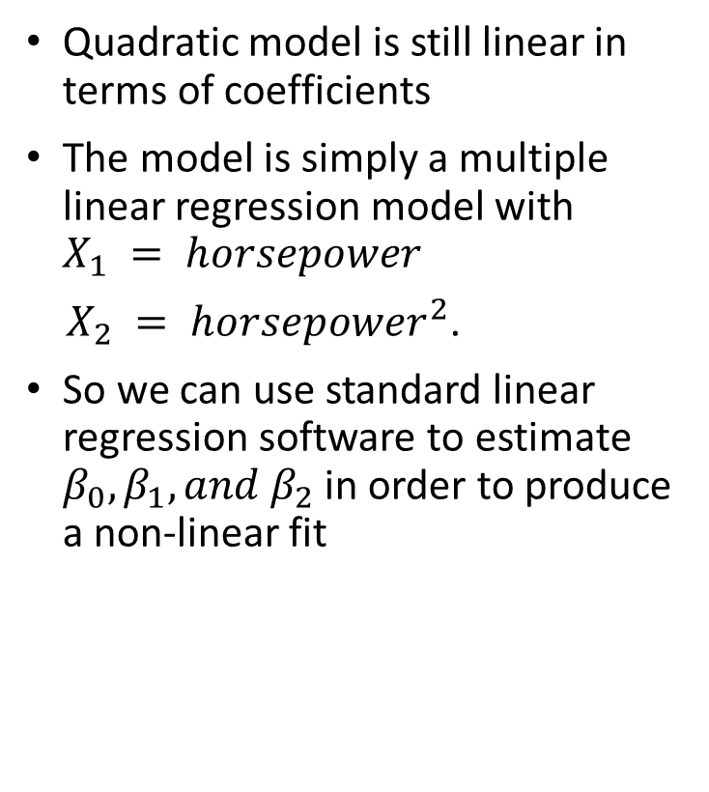
Linear Regression Extensions: Non-Linear Relationship
Quadratic model is still linear in terms of coefficients
The model is simply a multiple linear regression model with $X_{1} = horsepower$
$X_{2} = horsepower^{2}$.
So we can use standard linear regression software to estimate $β_{0}, β_{1}, and β_{2}$ in order to produce a non-linear fit

Slide 33
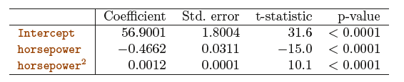
Linear Regression Extensions: Non-Linear Relationship
If including horsepower^2 led to such a big improvement in the model, why not include horsepower^3, horsepower^4, or even horsepower^5?
Overfitting ☺

